Slide 1
Predicting Liquor Store Profitability by County

Slide 2
What Factors Were Considered?
I looked at a host of factors for liquor sales:
Wholesale liquor prices
Retail liquor price
Volume of liquor sold per county
Employment Data
Housing Data
Population Data

Slide 3
Narrowing Down Important Factors
After exploring many different variables that could affect the success of a liquor store, I narrowed down the three most important factors.
Saturation Level
Consumption Per Person
House Values
Additionally, I adjusted for population estimates in 2020

Slide 4
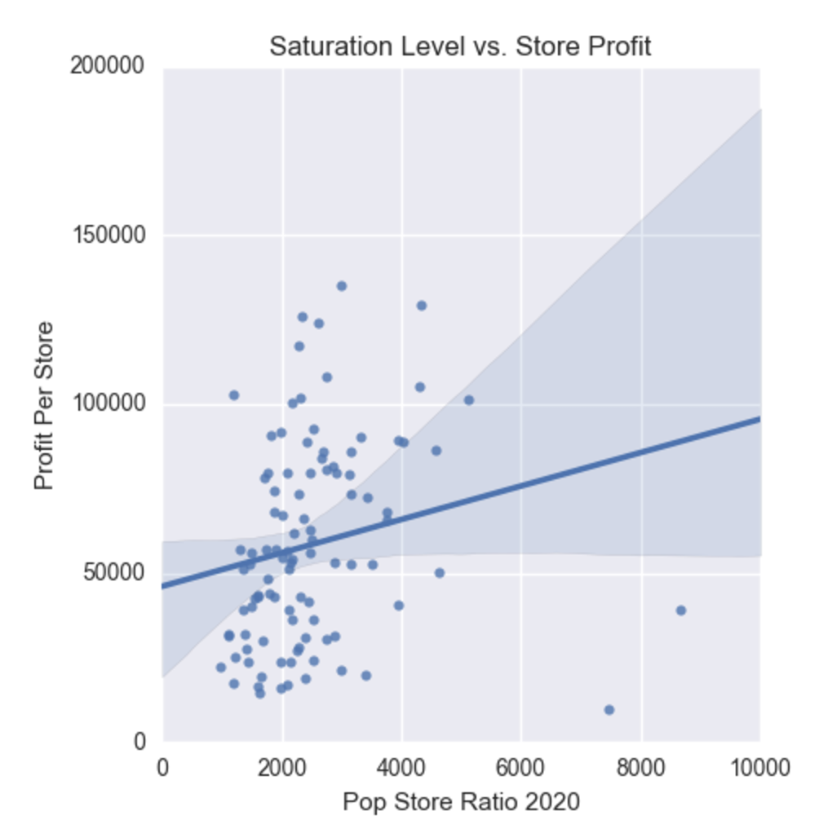
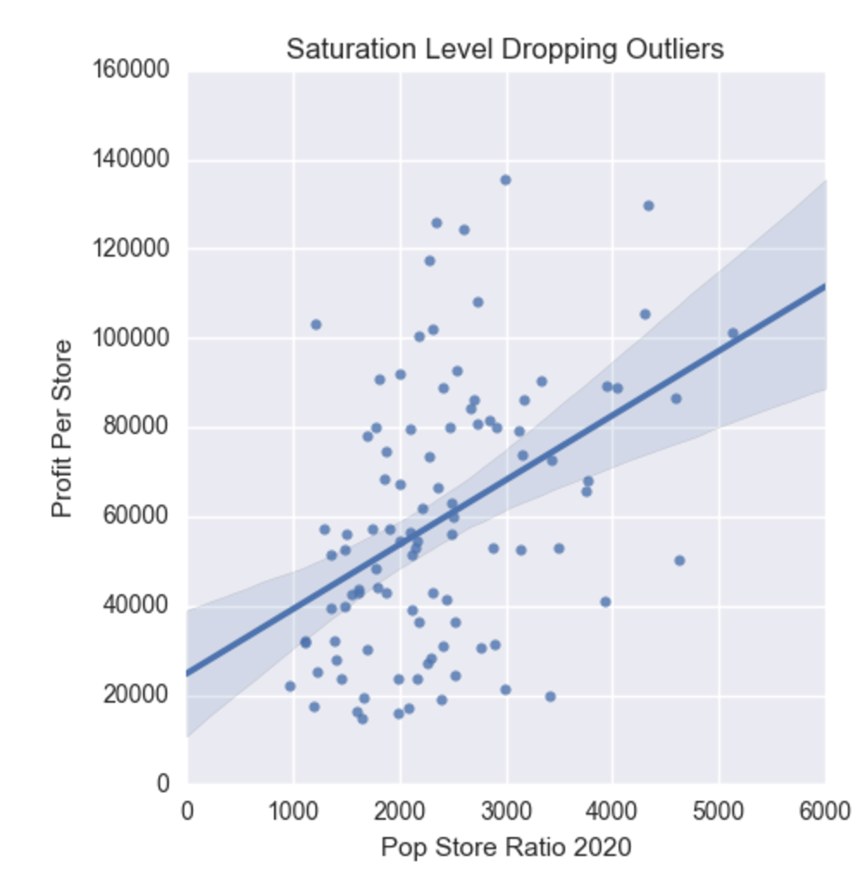
Saturation Level

Slide 5
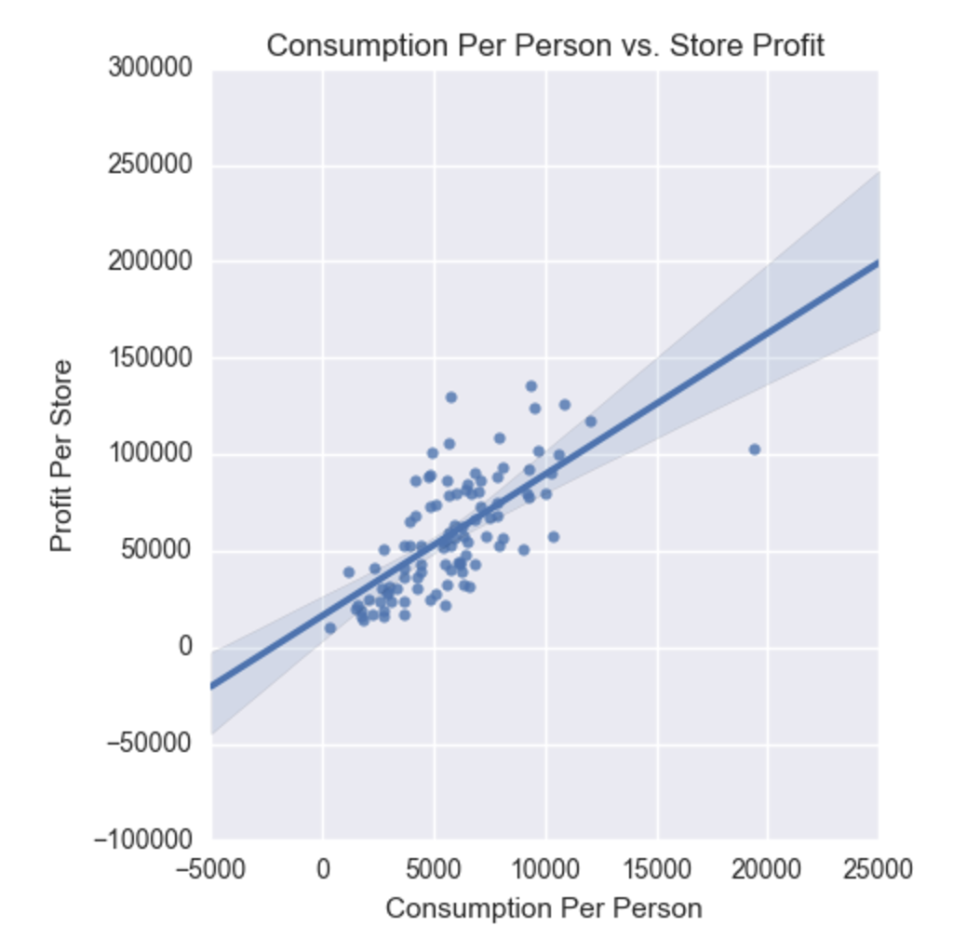
Liquor Consumed Per Person
People don’t consume liquor at the same rates across counties.
Religion
College Present
Age and Race

Slide 6
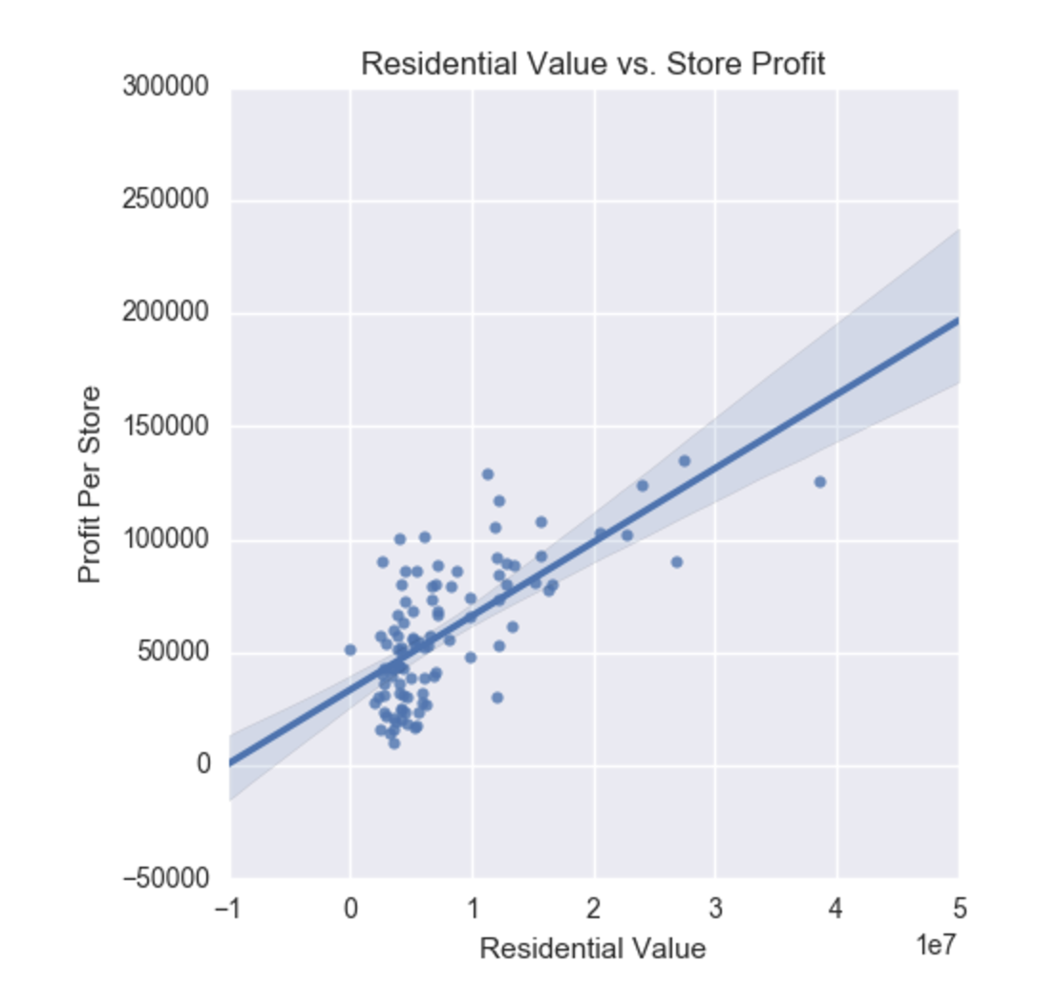
Total House Values by County
Measure of population weighted by wealth

Slide 7
What Does This Mean?
You are now equipped to narrow your search significantly into target counties.
What Does This Not Mean?
You know what street to open your shop.

Slide 8
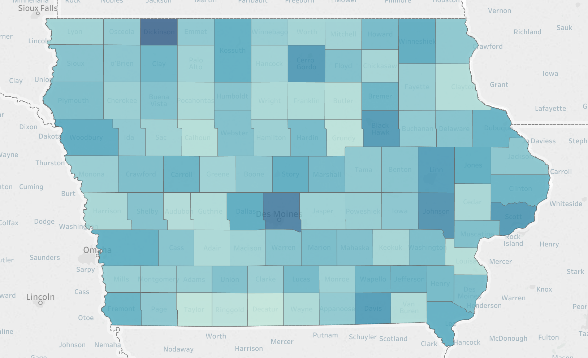

Slide 9
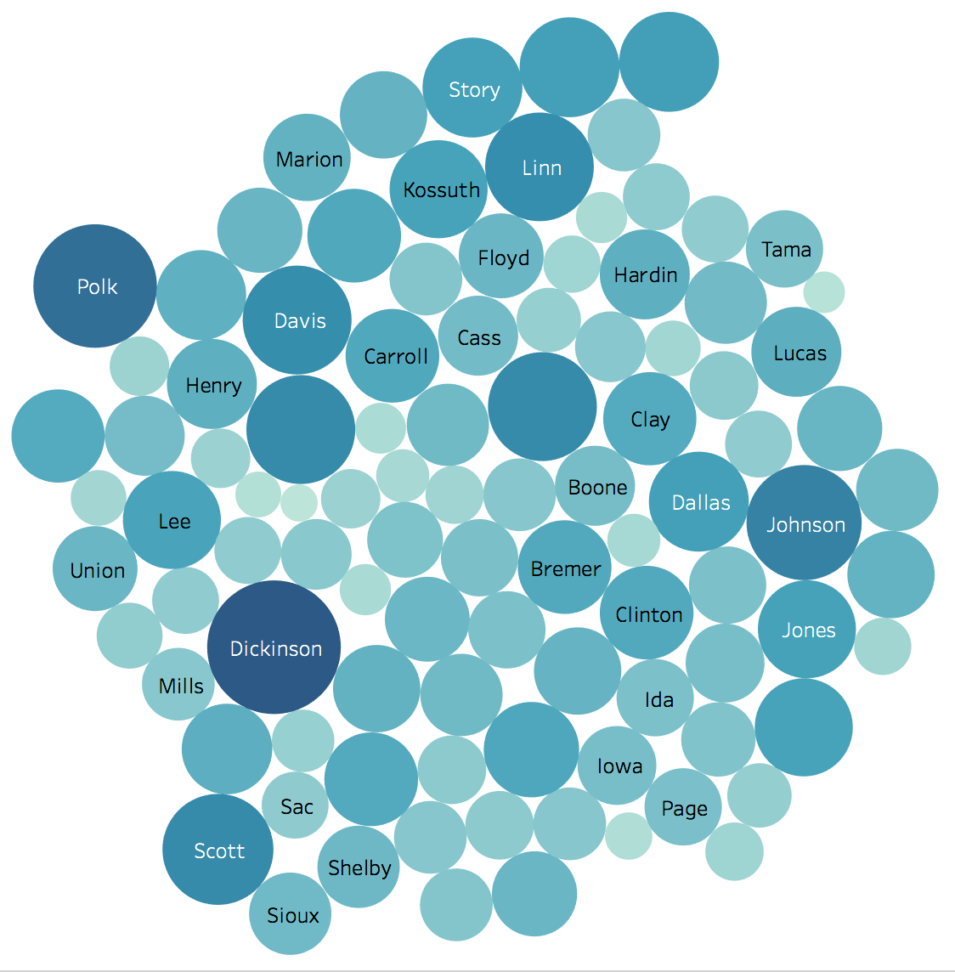
Estimated 2020 Profit
Dickinson: $161,297
Polk: $137,861
Johnson: $119,782
Scott: $111,252
Davis: $107,118

Slide 10
Location Location Location
Rent prices can be street specific, thus, preliminary research focused more broadly on overall overall liquor market conditions by county.
Accounted for the costs incurred for merchandise but did not account for overhead such as rent.
Further analysis will revolve around on site scouting of locations and concrete rent prices. Estimating rent may be dangerous due to the street and feature specific nature of rent prices.

Slide 11
Additional Considerations
You will have to delve deeper into these decisions:
The demographic you want to serve
Possibility for theft

